Slide 1
TCP Sockets (part 1)
Connection-related functions, Socket options, TCP client-server and Concurrent servers.
Chapter 4 and 5

Slide 2
TCP
Simple…Complex..
State
Reliable
APPLICATION
Stream Oriented
TCP
IPv4
IPv6

Slide 3
Stream vs Message TCP vs UDP
UDP
Message Oriented
Message boundaries preserved
Each Message Independent
Unreliable
No Error Recovery
No Flow Control
No Congestion Control
TCP
Byte Oriented
No message boundaries
One stream of data
Reliable
Retransmission of lost data
Flow Control
Congestion Control

Slide 4
Byte Steam
Send order
1 2 3 4 5 6 7 8….
a b c d e
15 135a af 3g
APPLICATION
APPLICATION
TCP
(IP)
1 2 3 4 5 6 7 8….
a b c d e
15 135a af 3g
Receive order

Slide 5
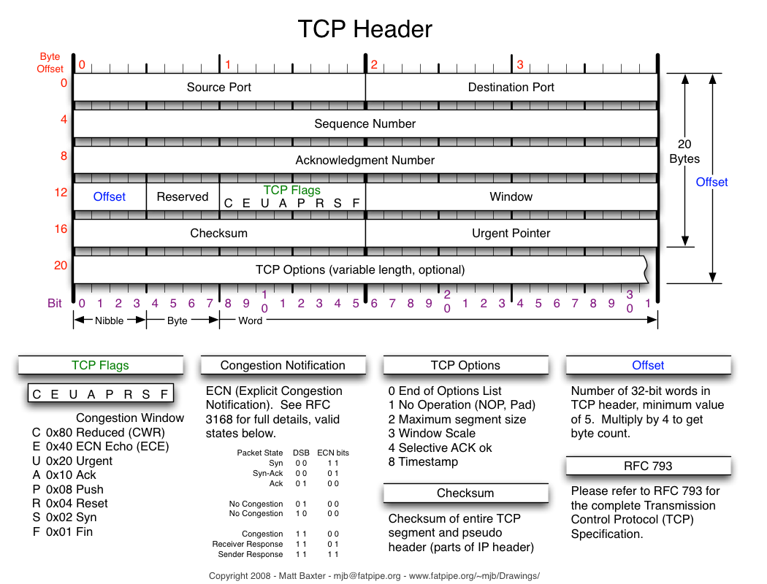

Slide 6
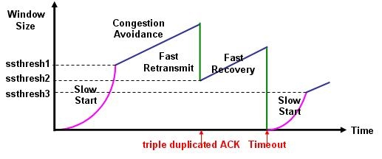
TCP Congestion Control

Slide 7
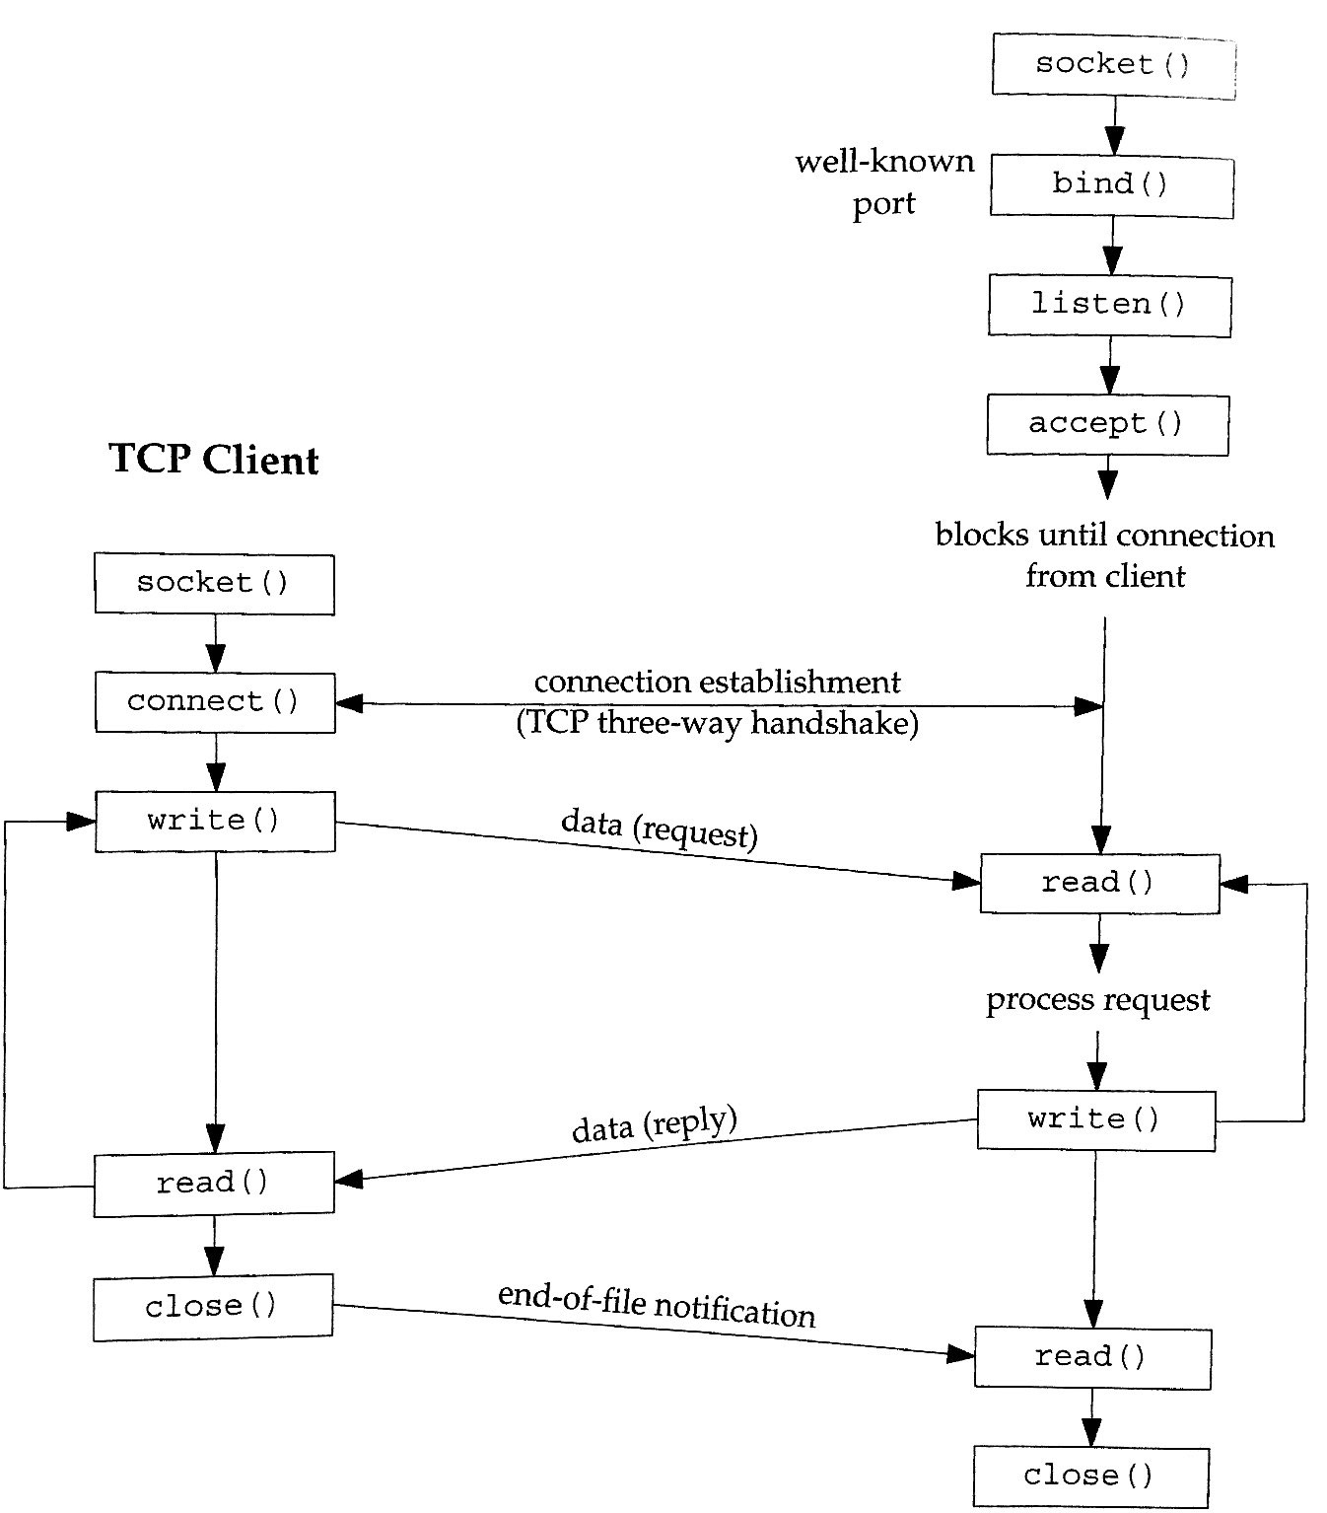
TCP client-server

Slide 8
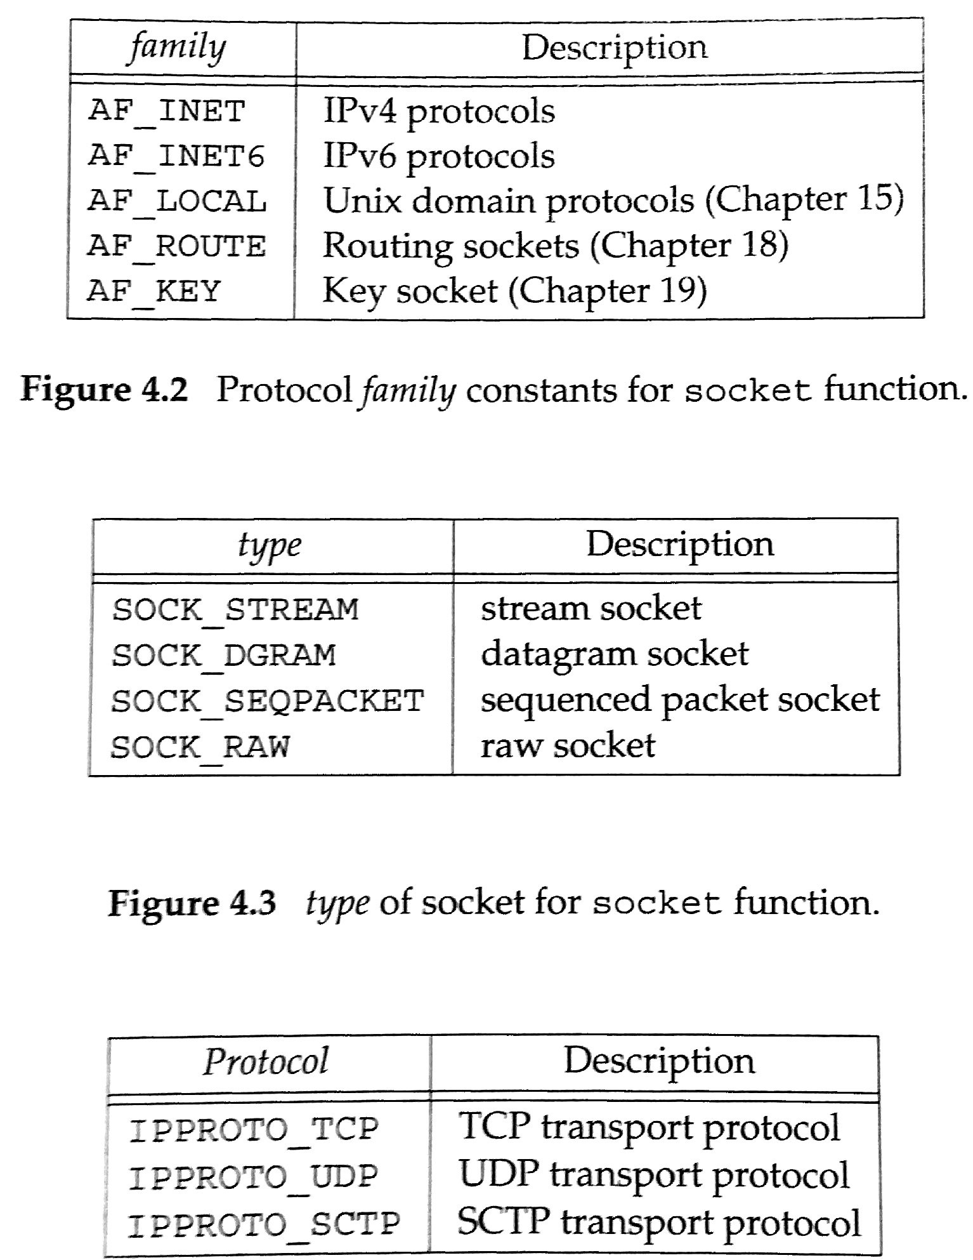
Socket
#include <sys/socket.h>
int socket(int family, int type, int protocol);
On Success, returns a non-negative integer, a socket descriptor.
#include <sys/types.h>
#include <sys/socket.h>
int socket(int domain, int type, int protocol);
Domain
AF_UNIX
AF_LOCAL
AF_INET
AF_INET6
AF_IPX
AF_NETLINK
AF_X25
AF_AX25
AF_ATMPVC
AF_APPLETALK
AF_PACKET
Type
SOCK_STREAM
SOCK_DGRAM
SOCK_SEQPACKET
SOCK_RAW
SOCK_RDM
SOCK_PACKET
Protocol
/etc/protocols
Not all combinations work

Slide 9
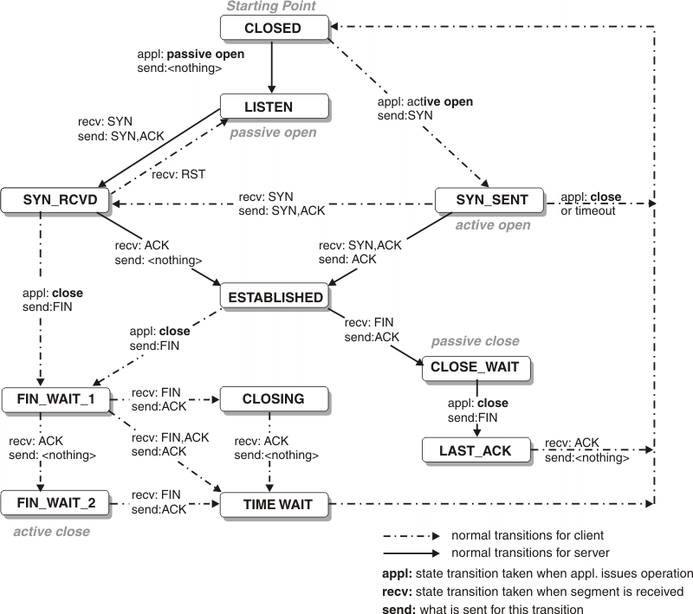
The TCP State Machine

Slide 10
The TCP State Machine
Server
Client

Slide 11
The TCP State Machine
Server
Client

Slide 12
The TCP State Machine
Client
Server

Slide 13
The TCP State Machine
Server
Client

Slide 14
The TCP State Machine
Server
Client

Slide 15
The TCP State Machine
Server
Client

Slide 16
The TCP State Machine
Server
Client

Slide 17
The TCP State Machine
Server
Client

Slide 18
The TCP State Machine
Client
Server

Slide 19
The TCP State Machine
Server
Client

Slide 20
The TCP State Machine
Server
Client

Slide 21
The TCP State Machine

Slide 22
Summary
TCP fundamentals
Reliability
Congestion Control
State Machine
Socket()

Slide 23
Connect()
#include <sys/types.h>
#include <sys/socket.h>
int connect(int sockfd, const struct sockaddr *addr, socklen_t addrlen);
Initiates a TCP connection towards the destination in addr.
Handles timeouts, retries, eventually fails.
Handles errors
Unreachable
Reset (RST)

Slide 24
Bind()
#include <sys/socket.h>
int bind(int sockfd, const struct sockaddr *addr, socklen_t addrlen);
Assigns a local address and port to a socket.
Process specifies |  | Result
IP Address | Port
Wildcard | 0 | Kernel chooses IP address and port
Wildcard | Non-zero | Kernel chooses IP address,process specifies port
Local IP address | 0 | Process specifies IP, kernel chooses port
Local IP address | Non-zero | Process specifies IP and port

Slide 25
listen()
#include <sys/socket.h>
int listen(int sockfd, int backlog);
Converts an active socket into a passive.
backlog specifies max. no. connections to que

Slide 26
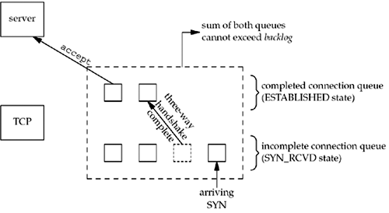
Kernel TCP Queues

Slide 27
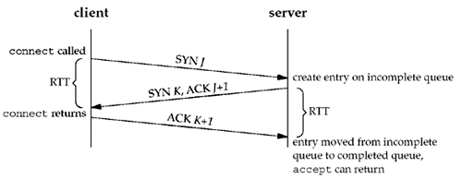
Three-way handshake + que

Slide 28
Accept()
#include <sys/types.h>
#include <sys/socket.h>
int accept(int sockfd, const struct sockaddr *addr, socklen_t addrlen);
Return’s the next completed connection from the completed connection que.

Slide 29
Simple Server
Client1
Server
Communicating
Client2
Established
Established
Client3
Blocked
(Established and incomplete que > backlog)
Service Time for a Client?
Client 2 Client dependency?
…
ClientN

Slide 30
Fork & Exec
#include <unistd.h>
pid_t fork(void);
#include <unistd.h>
int exec{l|v|le|ve|lp|vp}(const char* …)
Initial Process
Initial Process
Fork
exec
Returns a new PID
Returns zero
Only if exec failed
Original Process
New Process
Original Process
New excutable
http://man7.org/linux/man-pages/man2/fork.2.html
http://man7.org/linux/man-pages/man2/fork.2.html

Slide 31
Fork (& Exec)
Some new data
pid_t Q;
Q=fork()
Q=14241
OP
OP
OP
fork
OP
OP
Some data
Q=0
Some other new data

Slide 32
Fork & Exec
OP
OP
OP
fork
OP
exec
Some data
Bob

Slide 33
Concurrent Servers
bind(listenfd,(struct sockaddr *)&serverAddress, sizeof(serverAddress));
listen(listenfd,5);
while(1){
//...
connfd=accept(listenfd,(struct sockaddr*)&clientAddress,&clientAddressLength);
if ( (pid=fork()) == 0) {
close(listenfd);
doit(connfd);
close(connfd);
exit(0);
}
close(connfd);//sock is closed BY PARENT
}
Client
connect()
Server
listenfd

Slide 34
Concurrent Servers
bind(listenfd,(struct sockaddr *)&serverAddress, sizeof(serverAddress));
listen(listenfd,5);
while(1){
//...
connfd=accept(listenfd,(struct sockaddr*)&clientAddress,&clientAddressLength);
if ( (pid=fork()) == 0) {
close(listenfd);
doit(connfd);
close(connfd);
exit(0);
}
close(connfd);//sock is closed BY PARENT
}
Server
Client
connect()
listenfd
connfd

Slide 35
Concurrent Servers
bind(listenfd,(struct sockaddr *)&serverAddress, sizeof(serverAddress));
listen(listenfd,5);
while(1){
//...
connfd=accept(listenfd,(struct sockaddr*)&clientAddress,&clientAddressLength);
if ( (pid=fork()) == 0) {
close(listenfd);
doit(connfd);
close(connfd);
exit(0);
}
close(connfd);//sock is closed BY PARENT
}
Server
Client
connect()
listenfd
parent
connfd
fork
Server
listenfd
child
connfd

Slide 36
Concurrent Servers
bind(listenfd,(struct sockaddr *)&serverAddress, sizeof(serverAddress));
listen(listenfd,5);
while(1){
//...
connfd=accept(listenfd,(struct sockaddr*)&clientAddress,&clientAddressLength);
if ( (pid=fork()) == 0) {
close(listenfd);
doit(connfd);
close(connfd);
exit(0);
}
close(connfd);//sock is closed BY PARENT
}
Server
Client
connect()
listenfd
parent
Server
child
connfd

Slide 37
Concurrent Server (fork)
listenfd
Parent
Spawns
Spawns
connfd
Child1
Child2
connfd
Child3
connfd

